Slide 1
Documentum Programming-(DFC/DFS/REST)
Notes:
Place the audio notes for this slide here

Slide 2

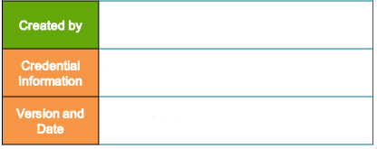
Priya Dorairaj (335190)
Enterprise Content Management Compétency
V 0.1, 3rd April 2018

Slide 3
Agenda
DFC
DFC Overview
DFC Communication Pattern
DFC Interface Hierarchy
DFC Programming Basics
Working with Document Operations

Slide 4
Agenda
DFS
DFS Overview
DFS Data Model
Object Services
Custom DFS Services

Slide 5
Agenda
REST
REST Overview
Custom REST Services

Slide 6
DFC Overview

Slide 7
DFC Overview
This chapter provides information on :
What is DFC?
Why DFC?
Where is DFC?
Importance of dfc.properties
Elements of dfc.properties
DFC Logging
Elements of log4j.properties

Slide 8
What is DFC?
DFC is the acronym for Documentum Foundation Classes and it is a set of Java Classes and Interfaces
Provides Object Oriented Application programming Interfaces (API) for interacting with content server programmatically
Full set of content server features is exposed via DFC
A DFC-based client is any application or component that connects to the Content Server using DFC

Slide 9
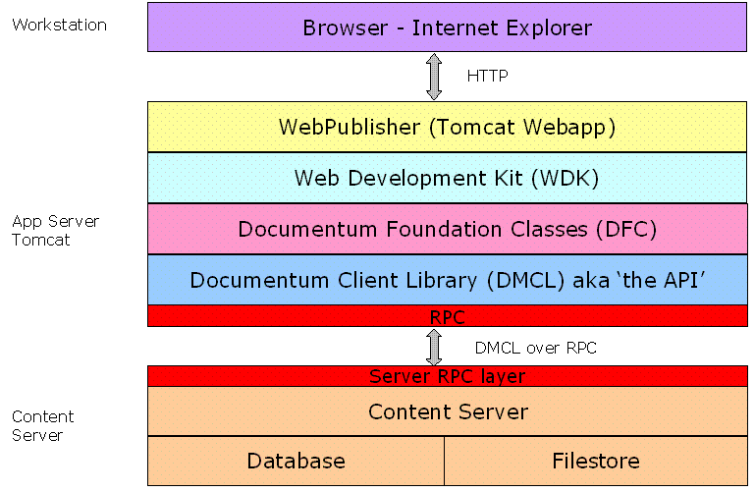

Slide 10
Why DFC?
Custom Application Interfaces can be created using DFC for user administration tasks
Provides Programmatic means for working with Documentum objects (User, Group, Folder, ACL, Document,…)
CRUD (Create, Read, Update, Delete) of Documentum objects can be achieved using DFC Programming

Slide 11
Where is DFC?
DFC runs on a Java virtual machine (JVM) which can be on
The machine that runs Content Server
Example: To be called from a method as part of a workflow or document lifecycle or to be executed on the Java Method Server on the Content Server host
A middle-tier system
Example: on an application server to support WDK or to execute server methods

Slide 12
Importance of dfc.properties
Each DFC instance is configured via a file named dfc.properties
This file contains name and port of a docbroker (Connection Broker) and global registry details
DFC can communicate with Content Server with the help of this file
When a user/application requests a repository connection, the requests goes to a connection broker identified in the client dfc.properties
File can be found within application folder on the application Server (WEBINF/Classes)
File can be found in $DOCUMENTUM/config in Content Server

Slide 13
Elements of dfc.properties
Configuring docbrokers (Mandatory- Atleast one connection broker)
The connection broker details should be defined like below in dfc.properties file
dfc.docbroker.host[0]=docbroker1.yourcompany.com
dfc.docbroker.port[0]=portno
Secondary Connection broker can be defined like below
dfc.docbroker.host[1]=docbroker2.yourcompany.com
dfc.docbroker.port[1]=portno
2. Tracing Options (Optional)
DFC has extensive tracing support. Trace files can be found in the directory which is mentioned in the dfc.data.dir in dfc.properties file
dfc.data.dir = C:\Documentum\logs

Slide 14
Elements of dfc.properties (Contd)
For enable tracing, add the below line in dfc.properties
dfc.tracing.enable = true
The logs will contain information about DFC entry calls, return values and parameters
3. BOF Information(Optional)
Add the below lines in dfc.properties, to point to global registry (to fetch SBO Implementation classes)
dfc.bof.registry.repository=devprog
dfc.bof.registry.username=dm_bof_registry
dfc.bof.registry.password=GrRNPhLJrkoTDAZE0RGJow==

Slide 15
Elements of dfc.properties (Contd)
4. Diagnostic mode (Optional)
DFC can run in diagnostic mode. Session leaks and collection leaks can be detected by including the below lines in dfc.properties
dfc.diagnostics.resources.enable=true
After enable this, unrelated session and unclosed collection information can be found in the logs

Slide 16
DFC Logging
Dflogger is a Documentum DFC Class that can be used to enable logging for DFC Applications
It can be achieved by creating log4j.properties.
Log4j is a java based logging utility primarily used as debugging tool.
Log4j.properties can reside in the same location like dfc.properties
In application layer : /WEBINF/log4j.properties
In Content Server : $DOCUMENTUM/config/log4j.properties

Slide 17
Elements of log4j.properties
log4j.logger.com.documentum.custom.webui=DEBUG,WebUI
com.documentum.custom is the package.webui is the class.So this particular class log information will be logged
In the webui DFC class, we should use DFLogger Class like
Syntax:
DfLogger.debug(Object arg0, String arg1, String[] arg2, Throwable arg3)
Syntax Explanation:
Object arg0 : specifies the class for which the debug message is being logged..
String arg1 : the message to log
String[] arg2 : parameters to use when formatting message
Throwable arg3 : a throwable to log ,can be used to print a stack trace to the log file in case of an exception.

Slide 18
Elements of log4j.properties (Contd)
DEBUG: the priority level
5 levels of priority is defined in log4j (DEBUG,INFO,WARN,ERROR,FATAL)
DEBUG – lowest level resulting all logged messages
If DEBUG is enabled in log4j.properties file, in our custom DFC Class if all 5 priorities are used like (Dflogger.debug,…) all the log information will be logged
If INFO is enabled in log4j.properties file, debug information will not be logged in log file even though Dflogger.debug is available in DFC Class
Running webui class file will result in creation of file WebUI.log file in defined location

Slide 19
Elements of log4j.properties (Contd)
2. log4j.appender.WebUI=org.apache.log4j.RollingFileAppender
specifies the type of appender to use. RollingFileAppender backs up log files once they reach a max size
3. log4j.appender.WebUI.MaxFileSize=10MB
specifies the maximum size of the log file. Once the file reaches this size, the appender backs it up and creates a new log file.
4. log4j.appender.WebUI.File=C\:/WebUI.log
specifies the name of the log file to be created as well as its location. In case the location is not specified, then the log file gets created in the
location of the executing class.
5. log4j.appender.WebUI.layout=org.apache.log4j.PatternLayout
specifies that a pattern layout is being used

Slide 20
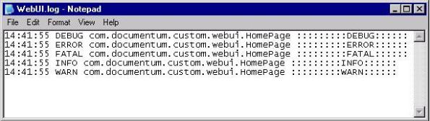
Elements of log4j.properties(Contd)
6. log4j.appender.WebUI.layout.ConversionPattern=%d{HH:mm:ss} %p %c %m %n
specifies the interpretation of the pattern layout. The conversion pattern used here is as follows :
%d{ HH:mm:ss}–date and time of logging, %p- priority level of the message, %c- name of the category (i.e the class/package name),%m- the message, %n- newline character.
Logfile (WebUI.log) will be like

Slide 21
DFC Communication Pattern

Slide 22
DFC Communication Pattern
This chapter provides information on :
What is DFC Communication Pattern?
Establishing a Session
Processing a request
Release Session

Slide 23
What is DFC Communication Pattern?
Consists of three stages
To do any work in the repository, first we need to establish a DFC session (connection) with Content Server instance
A Session (IDfSession) maintains a connection to the repository and gives access to the objects in the repository for a specific user. Before establishing a connection, user credentials are authenticated
The Session is released

Slide 24
Establishing a Session
The following figure illustrates the process of establishing a session with a Content Server instance
DFC-based Client
Connection Broker
1
2
Repository
DFC
Content Server
3
dfc.properties

Slide 25
Establishing a Session (Contd)
DFC reads dfc.properties file, which provides connectivity information for connection brokers and DFC is initialized
Using initialized DFC instance, the session is established as follows:
A Client issues a connection request to DFC with the repository name and user credentials
DFC requests the connection broker to provide information about the content server instances serving the specified repository.
DFC establishes a session with content server instance. This session is provided to the client for performing content server operations

Slide 26
Processing a request
The following figure illustrates the processing of a request by a Content Server instance
DFC-based Client
Connection Broker
1
DFC
Content Server
Repository
2
3
dfc.properties

Slide 27
Processing a request
The Client issues a request to the DFC instance along with the session
Using the DFC Session, DFC passed the request to the Content Server instance
The Content Server instance processes the request and interacts with the repository. Once the processing is complete the results are passed back on the reverse path back to the client
Release Session
Once the session is no longer needed it can be released
After this point any additional requests will require establishing a new session

Slide 28
DFC Interface Hierarchy

Slide 29
DFC Interface Hierarchy
DFC exposes most of the Documentum object hierarchy as a set of interfaces. Interfaces do not specify implementation
Interfaces defines the set of methods with specific signatures and specific semantics. DFC includes default implementation for each interfaces
For Ex :
To operate on a Document object, obtain an IDfDocument interface from DFC. This interface allows user to read or set the object attributes, attach content to the object, check the object into or out of a Docbase
User don’t want to know about implementation class(DfDocument)
DFC does not provide interface for every server object type. Sometimes we must use the DFC Interface that corresponds to a supertype for a given object type
For Ex : To operate on Cabinets, obtain an IDfFolder interface (dm_folder is the parent or supertype of dm_cabinet)

Slide 30
DFC Interface Hierarchy (Contd)
Some DFC interfaces correspond to operations that are independent of server object types
For Ex:
IDfLoginInfo interface which allows to assemble and maintain access information. There is no corresponding server object type
IDfPersistentObject interface defines functionality common to all server objects that derive from dm_persistentobject. The type dm_persistentobject is the base type of all server objects that persists beyond the current session but couldn’t create dm_persistentobject in the server.
Note : The Server only allows the creation and querying of objects of types that are subtypes of dm_persistentobject

Slide 31
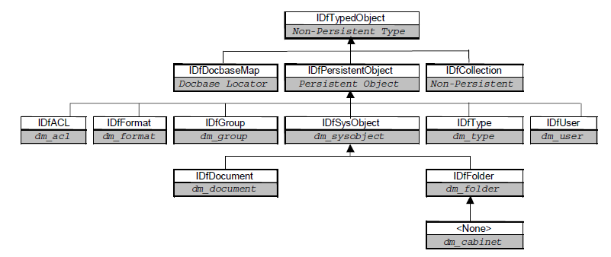
DFC Interface Hierarchy (Contd)
DFC Hierarchy corresponds to Documentum Object Hierarchy

Slide 32
DFC Interface and Description
Interface | Description
IDfTypedObject | Provides basic operations for all typed objects
IDfPersistentObject | Extends IDfTypedObject and it is base class for all Documentum persistent Objects
IDfCollection | Provides access to collection objects
IDfSysObject | Provides the functionality for the client to interact with ‘dm_sysobject’ objects in the repository
IDfDocument | Provides the functionality for the client to interact with ‘dm_document’ objects in the repository
IDfFolder | Provides the access to folder related data stored in folder objects
IDfQuery | Provides functionality for running queries against a repository
IDfClient | Provides functionality to establish and manage sessions
IDfSessionManager | Manages identities, pooled sessions and transactions
IDfSession | Encapsulates a session with a Documentum repository

Slide 33
IDfDocument Interface&Methods-Sample
Syntax: Public interface IDfDocument extends IDfSysObject
Methods:
The below are the few methods of IDfDocument
Signature | Description
setObjectName(String objectName) | Set the object name attribute of the object
setFile(String fileName) | Sets the content file of this object or replaces an existing content.
setRepeatingString(String attributeName, int valueIndex, String value) | Sets a string value of a repeating attribute
setContentType(String contentType) | Sets the file format of the object's content.
link(String folderSpec) | Associates the object with a folder or cabinet
save() | Saves an object to a Documentum server

Slide 34
IDfUser Interface&Methods-Sample2
Syntax: Public interface IDfUser extends IDfPersistentObject
Purpose: Provides access to user-related data stored in user objects
Methods: The below are the few methods of IDfUser
Signature | Description
setUserName(String userName) | Sets the name of this user.
isGroup() | Returns a Boolean value indicating whether a user is a group or an individual user.
getUserLoginName() | Returns the user's Documentum user login name.
setDefaultACL(String aclName) | Sets the default ACL for this user to a system ACL (owned by the repository owner).
setWorkflowDisabled(boolean disabled) | Sets whether this user is workflow disabled
getACLDomain() | Returns the domain of the ACL associated with a user

Slide 35
Test Your Understanding
Non Persistent Objects are
IDfSysobject
IDfCollection
IDfUser
All the above
Ans: b

Slide 36
Test Your Understanding
Priority levels in log4j.properties
DEBUG
FATAL
ERROR
All the above
Ans: d

Slide 37
DFC can be called only from WDK Layer
True
False
Ans: b (It also called from methods hosted in Content server)

Slide 38
DFC Programming basics

Slide 39
DFC Programming basics
This chapter provides information on :
Session Creation
Best Practices -Sessions
Creating Document
Updating Metadata
Deleting Objects
Query Execution

Slide 40
Session Creation
DFC Code to create Documentum Session (IDfSession)
Obtain an IDfClientX object
IDfClientX cx = new DfClientX();
Obtain an IDfClient object by calling the getLocalClient method of the IDfClientX object
IDfClient client = cx.getLocalClient();
Obtain a session manager by calling the newSessionManager method of the IDfClient object.
IDfSessionManager sMgr = client.newSessionManager();
Obtain an IDfLoginInfo Object and set user name ,password
IDfLoginInfo loginInfo = cx.getLoginInfo()
loginInfo.setUser( “userName" );
loginInfo.setPassword( “password" );
Using setIdentity Method in SessionManager, set repository name and loginInfo
sMgr.setIdentity( strRepositoryName, loginInfo );

Slide 41
Session Creation (Contd)
With the help of session manager, obtain a session with the repository and reference to the object that implements the IDfSession Interface
IDfSession session = sMgr.getSession(strRepoName);
With the help of this session, we can perform any operations and manipulations of objects in the repository
Once Session is not actively used, we can release session using SessionManager Object and get new sessions when needed than to store sessions for later use
sMgr.release(session);
To verify how many sessions are available. We can validate by executing the list_sessions or show_sessions using API or DQL
getLoginTicket() API is to provide additional sessions for a user who has an authenticated session

Slide 42
Best Practices - Sessions
Ensure that sessions are always obtained or released using the session manager and it is recommended to release session immediately after use
It is must important to release the sessions in finally block to ensure that it gets released in the event of an error or exception
This helps to avoid problems like session leaks, in which sessions are created and remain open
Do not store session objects at a location where the release of objects cannot be guaranteed. For Ex: it is a bad practice to store a session object as a class member variable or in a cache
It is not recommended to use IdfSession.disconnect() method to disconnect a session. A session must always be released with the same session manager release() method through which the session was acquired

Slide 43
Set up DFC Development Envt in Eclipse
Minimum requirement to set up DFC development environment
dfc.jar
All jar files located in C:\Program Files\Documentum\Shared
dfc.properties and log4j.properties
Lets see how to create DFC Project in Eclipse
Create New Java Project
Right Click on the project, Click Configure build path
Add External Jars (all the jars as mentioned above)
Add the dfc.properties and log4j.properties in /src folder

Slide 44
Creating Document
Lets see DFC Code to create dm_document object in the docbase
Step 1: Create Documentum Session (idfSession)
Step 2: With the help of idfSession, follow the below steps
IDfDocument documentObj = (IDfDocument) idfSession.newObject(“dm_document”);
documentObj.setObjectName(“Test-Document”);
documentObj.setContentType(“crtext”);
documentObj.setFile(“C:\\Documentum\\config\\dfc.properties”);
documentObj.link(“/Cabinet Name/Folder Level 2”);
documentObj.save();
Step 3: Release idfSession in finally block

Slide 45
Updating Metadata
Lets see how to update object_name,authors attribute for the document ‘NewDocument’ which is residing in the folder ‘/Training Cabinet/Folder Level 1’
Step 1: Create Documentum Session (idfSession)
Step 2: With the help of idfSession, follow the below steps
IDfSysObject sysObject = (IDfSysObject)idfSession.getObjectByPath(“/Training Cabinet/Folder Level 1/New Document”); //Get the Object Control
sysObject.setString(“object_name”, “New Document”); //set the object name
sysObject.setRepeatingString(“authors”,1,”RamKumar”); //set authors
sysObject.save();
Step 3: Release idfSession in finally block
Note : setRepeatingString method helps to set the string at the respective index. Ramkumar value will be set at ‘1’ st index of authors attribute. authors is the repeating attribute

Slide 46
Deleting Objects
DFC Code to delete the document and all versions of the document
Step 1: Create Documentum Session (idfSession)
Step 2: With the help of idfSession
IDfSysObject sysObject = (IDfSysObject) idfSession.getObjectByPath(“/Training Cabinet XXX/Folder Level 1/Test-Document”);
sysObject.destroyAllVersions(); // delete all versions
Step 3: Release idfSession in finally block

Slide 47
Query Execution
Executing DQL Queries is one of the most frequent tasks developed in Documentum application. Lets See how to execute the query using DFC Code
Step 1: Create Documentum Session (idfSession)
Step 2: With the help of idfSession, execute the query
IDfCollection col = null;
IDfQuery q = new DfQuery(); // create query object
q.setDQL(query); // set query string
col = q.execute(idfsession, DfQuery.DF_READ_QUERY); // execute query
Note : DF_READ_QUERY is used if it is select statement. DF_EXEC_QUERY if it is update/delete statement. The proper use of query type can affect your query performance

Slide 48
Query Execution (Contd)
DFC Code to process the results returned in IDfCollection Object
while (col.next()) { //process results in IDfCollection
IDfTypedObject tObj = col.getTypedObject(); // get each row
String id = tObj.getString("r_object_id"); // get value in each column
String name = tObj.getString("object_name");
}
//Closing Collection
Once collection is processed, it needs to be closed
If(col!=null){
col.close();
}
Step 3: Release idfSession in finally block

Slide 49
Working with Document Operations

Slide 50
Working With Document Operations
This chapter provides information on :
Types of Operations
Import into repository
Checkout from repository
Checkin to repository

Slide 51
Types of Operations
Operations are used to manipulate documents in Documentum
Task | Operation Type | Operation Node Type
Import into a repository | IDfImportOperation | IDfImportNode
Export from a repository | IDfExportOperation | IDfExportNode
Check into a repository | IDfCheckinOperation | IDfCheckinNode
Check out of a repository | IDfCheckoutOperation | IDfCheckoutNode
Cancel a checkout | IDfCancelCheckout Operation | IDfCancelCheckout Node
Delete from a repository | IDfDeleteOperation | IDfDeleteNode
Copy from one repository location to another | IDfCopyOperation | IDfCopyNode
Move from one repository location to another | IDfMoveOperation | IDfMoveNode

Slide 52
Import into repository - DFC
Step 1: Create Documentum Session (idfSession)
Step 2: The file ‘Test-Document’ from local needs to be imported into the cabinet ‘/Cabinet Name/Folder Level 2’
Step 3: Get folder control where object needs to be imported
IDfSysObject sysObj= (IDfFolder) idfSession.getObjectByPath (“/Cabinet Name/Folder Level 2”);
Step 4: Initiating object which performs complete client import of one or more nodes
IDfImportOperation importOpr = new DfImportOperation();
Step 5: set session used to create new docbase objects
importOper.setSession(idfSession);
Step 6: folder where new objects will be created
importOpr.setDestinationFolderId(sysObj.getObjectId());
Step 7:set symbolic version labels will be applied when the code is checked in importOpr.setVersionLabels(“imported using operation”);
IDfImportNode node = (IDfImportNode) importOpr.add (“C:\\Documentum\\config\\ Test-Document”);
node.setFormat(“pdf”);
boolean flag = importOpr.execute(); //flag – true it means import is success
Step 8: Release idfSession in finally block

Slide 53
Checkout from repository - DFC
Step 1: Create Documentum Session (idfSession)
Step 2: The file ‘Test-Document’ needs to be checked out in the cabinet ‘Training Cabinet XXX/Folder Level 2/’
Step 3: The checkout operations obtains a repository lock. Initiates the interfaces IDfCheckoutOperation
IDfCheckoutOperation checkoutOpr = new DfCheckoutOperation();
Step 4: Sets the file system directory path that is the default output location for the outbound content files.
checkoutOper.setDestinationDirectory(checkoutOpr.getDefaultDestinationDirectory());
Step 5 : Gets the SysObject control of which object needs to be checked out
IDfSysObject sysObj = (IDfSysObject) idfSession.getObjectByPath(“/Cabinet Name/Folder Level 2/ Test-Document”);
Step 6: Add the object to Node IDfCheckoutNode IDfCheckoutNode node = (IDfCheckoutNode) checkoutOpr.add(sysObj);
Step 7 : Execute the operation
boolean flag = checkoutOpr.execute();
Step 8 : Release idfSession in finally block

Slide 54
CheckIn to repository - DFC
Step 1: Create Documentum Session (idfSession)
Step 2: The file ‘Test-Document’ needs to be checked in the cabinet ‘Training Cabinet XXX/Folder Level 2/’
Step 3: Initiates the interfaces IDfCheckinOperation
IDfCheckinOperation checkinOpr = new DfCheckinOperation(); Step 4 : Gets the SysObject control of which object needs to be checked in
IDfSysObject sysObj = (IDfSysObject) idfSession.getObjectByPath(“/Cabinet Name/Folder Level 2/ Test-Document”);
Step 5: Add the object to Node IDfCheckinNode IDfCheckinNode node = (IDfCheckinNode) checkinOpr.add(sysObj);
Step 6 : Execute the operation
boolean flag = checkinOpr.execute();
Step 7 : Release idfSession in finally block

Slide 55
Test Your Understanding
To work on cabinets, interfaces used
IDfCabinet
IDfFolder
Either a or b
All the above
Ans: b

Slide 56
Test Your Understanding
Method to get the group name in IDfGroup Interface
getObjectName
getGroupName
getObject
Either a or c
Ans: a

Slide 57
Test Your Understanding
Release idfSession in try block
True
False
Ans: b (It should be released in finally block)

Slide 58
Hands On
Create folder under ‘test’ Cabinet. Set the Folder Metadata like Folder Name, ACL. After create, validate folder existence in Documentum Administrator
Create the dm_group object. Set the group name like ‘testGroup’. Add some users and groups which is available in the repository
Get all the subgroups from the group ‘testGroup’

Slide 59
DFS Overview

Slide 60
DFS Overview
This chapter provides information on :
Web Services Overview
SOA Architecture
What is DFS?
DFS and DFC Difference
ECS Overview
DFS Services – Out of Box

Slide 61
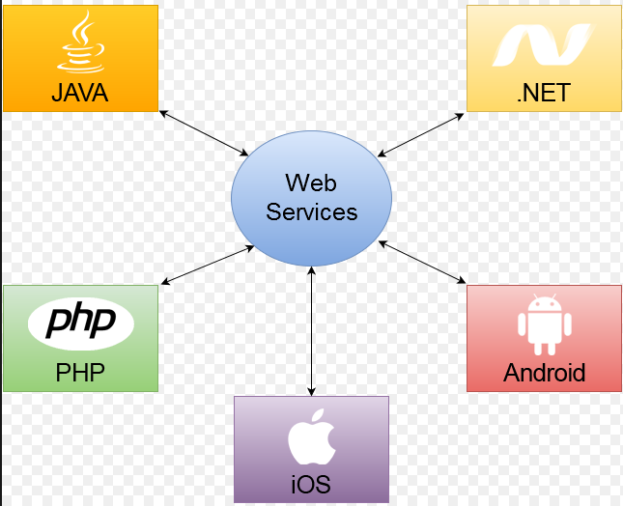
Web Services Overview
Web Services are defined using WSDL (Web Service Definition Language)
Web Service purpose is to exchange of data using standard protocol SOAP in the form of XML from client to server independent of platform and programming language. Java language running on Windows can communicate with PHP running on Unix where web services are hosted

Slide 62
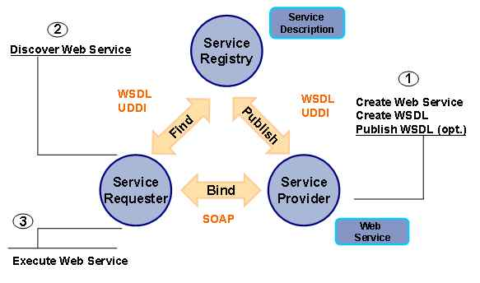
SOA Architecture
Service Provider(Publisher) creates Web Services and informs Service Registry(Broker) about the existence of Web Services –Publish
Service Requestor(Consumer) is the client application consults with service registry to locate a published web service-Find
With the information gained from Service Registry about the webservice, requestor is able to bind or invoke web service-Bind

Slide 63
SOA Architecture (Contd)
Lets see the real time example GlobalWeather Service is deployed and will return the weather status based on the city
From Android App, we can get the weather status by sending request ‘cityname’ to the GlobalWeather webservice
From iOS App, we can get the weather status by sending request ‘cityname’ to the GlobalWeather webservice
Note : The webservice response will be same even though it is consumed by different platforms

Slide 64
What is DFS?
DFS is the acronym for Documentum Foundation Services
Service layer over a DFC Client which connects to one or more Documentum repositories managed by the content Server
DFS is designed around the goals and principles of SOA
Provides Service Oriented Programmatic access to the Documentum Content Server platform via webservices using standards and protocols
DFS Provides a Service Oriented framework and API used to develop Enterprise Content Services(ECS) and consumers of Enterprise Content Services

Slide 65
DFS and DFC Difference
DFS | DFC
Service Oriented API to interact with Documentum | API to interact with Documentum
Session Managers and sessions are not part of DFS | Session Managers and sessions are part of DFC
Low Level customization is not possible with DFS | Low Level customization is possible with DFC
DFS has generic DataObject Class that can represent any object type | DFC has API for every object Type (like IDfDocument for dm_document)
Document Object Creation, update and delete can be done using Object Services | Using IDfDocument API, it can be achieved
Checkin and checkout of objects can be done using Version Control Services | Using IDfCheckin and IDfCheckout Operation and Node, it can be achieved

Slide 66
ECS Overview
ECS is the acronym for Enterprise Content Services
Set of Services based on Documentum Foundation Services technology
All the Services are based on common framework and can be consumed using DFS Java
DFS is a product offering initial ECS package of essential platform services from EMC
It also contains SDK to support custom service development
DFS application package in dfs.ear file. Consists of two parts Client libraries (SDK) and server application

Slide 67
DFS Services – Out of Box
Module Name | Service
core | Object Service
 | Version Control Service
 | Access Control Service
 | Schema Service
 | Life Cycle Service
 | Query Service
 | Virtual Document Service
Bpm | Workflow Service
 | Task Management Service
Search | Search Service

Slide 68
DFS Data Model

Slide 69
DFS Data Model
This chapter provides information on :
Overview
Primary Data Model
DataPackage
DataObject
ObjectIdentity
ObjectIdentitySet
PropertySet
DFS Authentication & Interaction

Slide 70
Overview
Data passed to and from the Services are encapsulated into DFS Object Model
Data Models are important part of service orientation
Services are about data and operations upon data.
DFS has a rich data model covering multiple aspects
Primary data model Objects
Data Package, DataObject, ObjectIdentity
Profiles
Property profile, Content Profile ,Schema Profile, Delete Profile
Others including identity,persistent objects, permissions,schema, exceptions

Slide 71
Primary Data Model
name
value
f
dataObjects
repositoryName:String
Container of
Property
DataPackage
Container of
Contents
Identity
Permissions
Properties
relationships
Properties
Repository
Name
value
Access to
DataObject
Properties
Ident
ifiable
by
PropertySet
ObjectIdentity
Access to relation
ship properties
DataObject
Container of
Access to Permissions
Name
Properties
targetRole
IntentModifier
name
type
Identities
Access to
children
And parents
ObjectIdentitySet
Permission
Relationship

Slide 72
DataPackage
Collection of DataObject instances
Object Service operations process all the DataObject instances in the DataPackage sequentially
DataObject dataObject = new DataObject(new ObjectIdentity("myRepository"));
DataPackage dataPackage = new DataPackage(dataObject);
// add a second data object using the add method in DataPackage
DataObject dataObject1 = new DataObject(new ObjectIdentity("myRepository"));
dataPackage.addDataObject(dataObject1);
//build list and then set the DataPackage contents to the list
ArrayList<DataObject> dataObjectList = new ArrayList<DataObject>();
dataObjectList.add(dataObject);
dataObjectList.add(dataObject1);
dataPackage.setDataObjects(dataObjectList);

Slide 73
DataObject
Representation of an object in ECM Repository such as dm_sysobject or dm_user
It includes identity, properties, content and relationships to other repository objects
DataObject and its related class
Class | Description
ObjectIdentity | Uniquely identifies the repository object. DataObject can have 0 or 1 identities
PropertySet | Collection of named properties. DataObject can have 0 or 1 PropertySet instances
Content | Contains data about file content associated with data object.DataObject contain 0 or more Content instances
Permission | Specifies basic or extended permissions or custom permissions. DataObject contain 0 or more Permission objects
Relationship | Defines relationship between repository objects. DataObject contain 0 or more Relationship instances

Slide 74
ObjectIdentity
uniquely identify a repository object
An ObjectIdentity instance contains a repository name and a unique identifier that can take various forms. Identifiers are OBJECT_ID,OBJECT_PATH and QUALIFICATION.
An ObjectID is a container for the value of a repository r_object_id attribute, which is a value generated by content server to uniquely identify a specific version of a repository object.
An objectPath contains a String expression specifying the path to a repository object, excluding the repository name.
A Qualification is an object that specifies criteria for selecting a set of repository objects.

Slide 75
ObjectIdentity (Contd)
Lets see how to create ObjectIdentity
String repName = "MyRepositoryName";
ObjectIdentity[] objectIdentities = new ObjectIdentity[4];
// repository only is required to represent an object that has not been created
objectIdentities[0] = new ObjectIdentity(repName);
// show each form of unique identifier
ObjectId objId = new ObjectId("090007d280075180");
objectIdentities[1] = new ObjectIdentity<ObjectId>(objId, repName);
Qualification qualification
= new Qualification("dm_document where r_object_id = '090007d280075180'");
objectIdentities[2] = new ObjectIdentity<Qualification>(qualification, repName);
ObjectPath objPath = new ObjectPath("/testCabinet/testFolder/testDoc");
objectIdentities[3] = new ObjectIdentity<ObjectPath>(objPath, repName);

Slide 76
ObjectIdentitySet
Collection of objectIdentity instances, which can be passed to an Object service operation so that it can process multiple repository objects in a single service operation
It is Analogous to DataPackage
String repName = "MyRepositoryName";
ObjectIdentitySet objIdSet = new ObjectIdentitySet();
ObjectIdentity[] objectIdentities = new ObjectIdentity[4];
// add some ObjectIdentity instances
ObjectId objId = new ObjectId("090007d280075180");
objIdSet.addIdentity(new ObjectIdentity(objId, repName));
Qualification qualification =
new Qualification("dm_document where object_name = 'bl_upwind.gif'");
objIdSet.addIdentity(new ObjectIdentity(qualification, repName));
ObjectPath objPath = new ObjectPath("/testCabinet/testFolder/testDoc");
objIdSet.addIdentity(new ObjectIdentity(objPath, repName));

Slide 77
PropertySet
DataObject optionally contains a PropertySet
Container for a set of Property Objects
Property Object represent a single property or array of properties of the same data type
Property[] properties =
{
new StringProperty("subject", "dangers"),
new StringProperty("title", "Dangers"),
new StringArrayProperty("keywords",
new String[]{"lions", "tigers", "bears"}),
};
PropertySet propertySet = new PropertySet();
for (Property property : properties)
{
propertySet.set(property);
}

Slide 78
DFS Authentication & Interaction
Lets see end to end process of connecting and authenticating with DFS and then retrieving a result set of objects from the repository
Service Context Creation:
ContextFactory contextFactory = ContextFactory.getInstance();
// Service Context Created via ContextFactory
IServiceContext serviceContext = contextFactory.newContext();
//Create RepositoryIdentityObject to store repository information
RepositoryIdentity repoId = new RepositoryIdentity();
repoId.setRepositoryName(repositoryName);
repoId.setUserName(userName);
repoId.setPassword(userPassword);
// Add the populated RepositoryIdentity to the ServiceContext
serviceContext.addIdentity(repoId);

Slide 79
DFS Authentication & Interaction (Contd)
DFS Service Instantiation:
In the below example, ObjectService instance is created using getRemoteService method in ServiceFactory Class
Arguments of getRemoteService:
Service Class : Type of service we want to invoke
Service Context : Service Context instance and populated with repository credentials
Service Module: Part of service URL that comes immediately after “/services”. In this case it is core
Context Root : Root of Service URL,before service module Name “/core”
// Get an ObjectService from the ServiceFactory
IObjectService objectService =
ServiceFactory.getInstance().getRemoteService(IObjectService.class,
serviceContext,"core","http://localhost:9080/services");

Slide 80
DFS Authentication & Interaction (Contd)
Get Objects from Repository:
In the below example, ObjectService instance helps to get object from the repository
Qualification q1 = new Qualification("dm_document where object_name='Test 1'");
Qualification q2 = new Qualification("dm_document where object_name = 'Test 2'");
// Create ObjectIdentity objects with our DQL qualifications and repository name
ObjectIdentity targetObjectIdentity1 = new ObjectIdentity(q1, repositoryName);
ObjectIdentity targetObjectIdentity2 = new ObjectIdentity(q2, repositoryName);
// Create an ObjectIdentitySet that contains the ObjectIdentity objects
ObjectIdentitySet objIdSet = new ObjectIdentitySet();
objIdSet.addIdentity(targetObjectIdentity1);
objIdSet.addIdentity(targetObjectIdentity2);
// Create an empty OperationOptions object
OperationOptions opts = new OperationOptions();
// Execute ObjectService.get() which hopefully returns a populated datapackage
DataPackage dataPackage = objectService.get(objIdSet, opts);

Slide 81
DFS Authentication & Interaction (Contd)
Iterate over the results
The call to the objectservice returns a DataPackage which must be iterated through to access DataObject. Each DataObject contains a PropertySet which can be used to access individual property values
// Create an empty DataPackage to hold the resulting objects
DataPackage dataPackage = new DataPackage();
// Create an empty PropertySet to hold the resulting object properties
PropertySet properties = new PropertySet();
// Iterate through the DataObject objects in the result DataPackage
Iterator iterator = dataPackage.getDataObjects().iterator();
while(iterator.hasNext()){
System.out.println(“Getting Properties”);
DataObject thisDataObject = (DataObject) iterator.next();
// Write out some properties for this DataObject
properties = thisDataObject.getProperties();
String objNme = properties.get("object_name").getValueAsString();
String crDate = properties.get(“r_creation_date").getValueAsString();
}

Slide 82
Object Control
Service

Slide 83
ObjectControl Service
This chapter provides information on :
Overview
Method Signature
Explanation
Object Service – DFS Call

Slide 84
Overview
Object Service is a core DFS Service
Provides fundamental operations related to repository objects
-create()
- createPath()
- copy()
- move()
- update()
- get()
- delete()
Object Service WSDL
http://<hostname>:<port>/services/core/ObjectService?wsdl

Slide 85
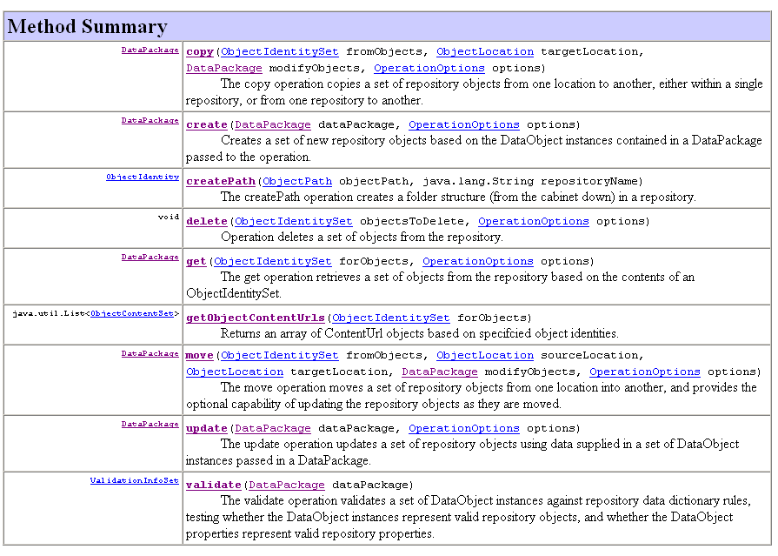
Method Signature

Slide 86
Explanation
Use ObjectService.create() to create new objects in the repository
Creates new objects based on the data objects that are contained in the DataPackage
DFS assigns a new object identifier once the object is created in the repository
To create object in a specific location or create objects that have relationship to one another defined in the repository use RelationShip instances with the DataObjects
Syntax of create Method:
DataPackage create(DataPackage dataPackage,OperationOptions
operationOptions) throws CoreServiceException

Slide 87
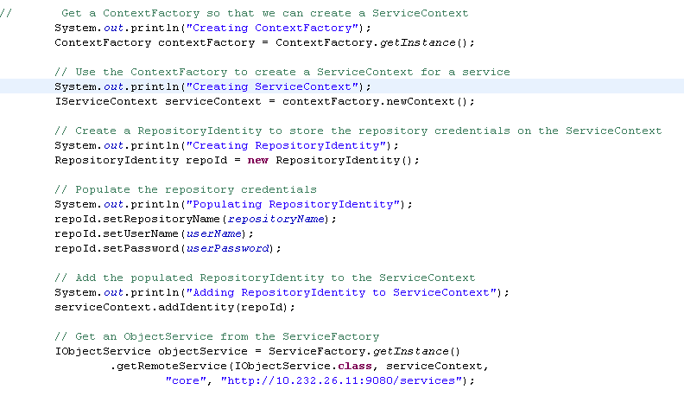
ObjectService –DFS Call

Slide 88
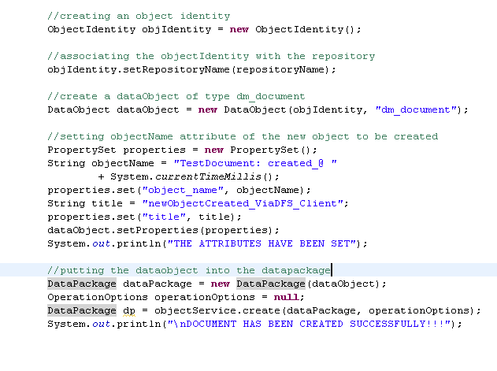
ObjectService –DFS Call (Contd)

Slide 89
Custom DFS Services

Slide 90
Custom DFS Services
This chapter provides information on :
DFS SDK
Custom Services
Annotations - DfsPojoServices
Simple DFS Services Creation

Slide 91
DFS SDK
Software development kit for development of DFS consumers
Includes Java class libraries which helps to build DFS Services that extend DFS delivered services
DFS uses DFC client bundled in DFS SDK
DFC client is configured in dfc.properties file that is located in project classpath (dfs-sdk-7.3\etc)
To run basic services, it is required to configure connection broker details in the properties file
To run workflow services or any services that require SBO, it is required to configure global registry user credentials in the properties file
Services can be implemented as POJOs or as BOF service based business objects
Tools rely on JAX-WS and JAXB which require annotations of the original service source code
Services should always return a DFS DataPackage rather than a specialized object representing DFC typed object

Slide 92
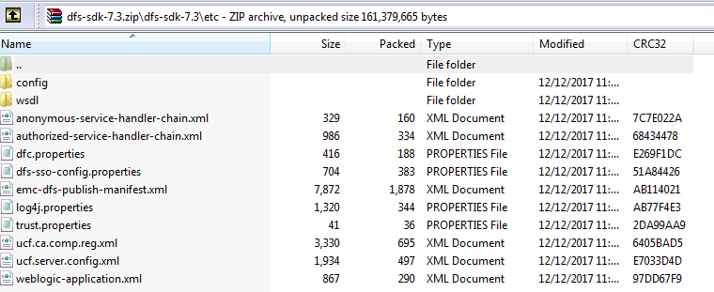
DFS SDK (Contd)
dfs-sdk-7.3\etc contains all configuration files
Download dfs.ear (Version 7.3) from OpenText
Download dfs-sdk-7.3 from OpenText which contains out of box services provided by OpenText

Slide 93
Custom Services
DFS is designed as a developer platform
Platform for consumers
Platform for custom services
Custom Services can be
Wrappers/Extenders of DFS Services
Peers to out-of-box DFS services
Steps to create:
Annotate a POJO or BOF
Use DFS tools (ANT tasks) to
Generate service artifacts
Package Custom Services
Deploy Custom Service applications

Slide 94
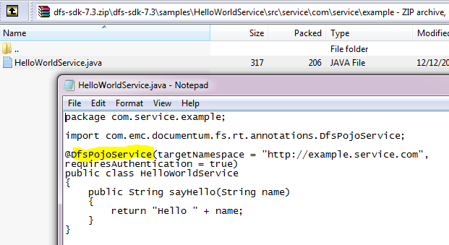
Annotations - DfsPojoService
POJO annotations simply serve as the metadata to the DFS service design time tools
Insert the annotation immediately above the service class(HelloWorldService)
targetNamespace overrides the default Java Package in reverse order.
requiresAuthentication default value is true. False means open service

Slide 95
Simple DFS Service Creation
Documentum Composer is used for developing DFS
Create New Documentum Project
Create Java Class HelloWorldService in webservices\src
package com.service.example; import com.emc.documentum.fs.rt.annotations.DfsPojoService; @DfsPojoService(targetNamespace = "http://example.service.com", requiresAuthentication = true) public class HelloWorldService { public String sayHello(String name) { return "Hello " + name; } }
Define Project Properties
Context Root : services
DFS Module Name : example

Slide 96
Simple DFS Service Creation (Contd)
Include dfc.properties in /etc/config
Edit DFS Services Library and specify that it is service
Compile the project and export as EAR File
Archive Name: example
Context Root: services
Rename the ear file as expected. Validate dfc.properties in \APP-INF\classes or copy to the location
Deploy the war in Application Server (weblogic/Apache/Tomcat,..)
Once deployed, verify the below WSDL
http:/YourAppServerHost:Port/services/example/HelloWorldService?wsdl
If WSDL displays, service is installed (Producer is completed) and ready to be consumed
Note : If out of box services needs to call then dfs-sdk-7.3 should be packaged inside this ear file

Slide 97
Test Your Understanding
DataPackage is used
Inside a datawarehouse object
As a platter for data samples
As a container for data objects
All the above
Ans: c

Slide 98
Test Your Understanding
DataObjects are used to represent repository objects
True
False
Ans: a

Slide 99
Hands On
Package dfs.ear file and deploy in the server. Invoke Out of box services
Write Custom services for create document like it should validate object name should starts with PROJ_ before creating it

Slide 100
REST Overview

Slide 101
REST Overview
This chapter provides information on :
Overview
REST and DFS Difference
HTTP Supported
Resource Extensibility
Resource Relationship
Cabinet – Resource Relationship
Cabinet – Link Relation

Slide 102
Overview
Documentum Platform REST Services is a set of RESTful Web Services that interacts with the Documentum platform
Programming language independent
We can consume REST Services using any programming language
Rely on DFC
Resources : In Documentum REST services, Objects in Repositories are called as Resources
Uniform Resource Identifiers (URIs) :Resources are identified by URIs
Supports two formats JSON and XML for resource representation

Slide 103
REST and DFS Difference
REST | DFS
Webservices can be called using browser through HTTP Protocol | Its not possible
Webservices really easy to test and use since it is lightweight | Its comparitively not easy
Performance is better than SOAP | Low performance
Doesn’t have official standard yet and can be implemented in many ways | SOAP has an official standard
Preferred API of the mobile community | Not Preferred

Slide 104
HTTP Supported
HTTP headers like Authorization,Accept,Content-Type,.. Are supported
HTTP codes like 200 OK,201 Created,… are supported
You can use URL extensions .xml and .json to negotiate the content type of the response
/repositories.xml returns collection of repositories in XML representation
/repositories.json returns collection of repositories in JSON representation
HTTP Methods like GET,POST,PUT,DELETE are supported

Slide 105
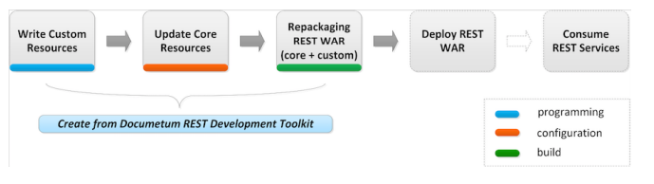
Resource Extensibility
API that enables you to extend Documentum REST services by composing,customizing and creating new REST resources
Please follow the below steps to create custom resources
Design and implement custom resources
Documentum REST services provides a toolkits and libraries
Set of core REST Java librares which optimizes the REST Services Development upon core REST Services
Marshalling Framework
Maven based Toolkit
Ant based Toolkit

Slide 106
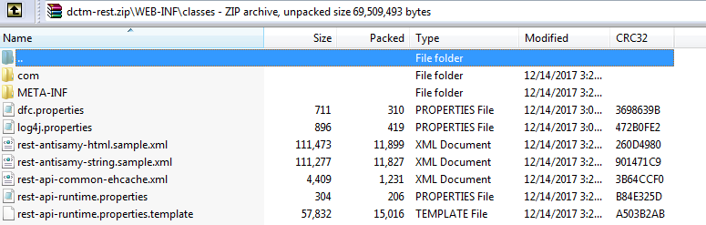
Resource Extensibility (Contd)
Customize Core REST resources
Repackage REST war file
Deploy War file in application server
Consume the extended Documentum REST Services
Download dctm-rest.war file from openText
dfc.properties are available in the below location. All other configuration files are also available in the same path

Slide 107
Resource Relationship
Link relation1
Resource 1
Link relation 2
Resource 2
Resource 0
Feed-entry
Target Resource
Link relation 3
Resource 3
Link relation 4
Resource 4
more
…

Slide 108
Resource Relationship (Contd)
Target Resource is bold
Link relations are presented as strings on arrows
Resource to left of Target Resource is the resource where you can navigate to the target resource
Resource to right of Target Resource is the resource which can be reached from target resource
String ‘More’ on arrows is not a link relation. It indicates more than four resources can be reached from target resource
String <feed-entry> on arrows is not a link relation. It indicates two resources are linked via feed to entry containership

Slide 109
Cabinet - Resource Relationship
Note : Root Element in XML/Name property in JSON is cabinet for Cabinet Resource
relations
Relations
Folder
Folder Child Folders
Cabinets
Feed-entry
Cabinet
Documents
Folder Child Documents
Objects
Folder Child Objects

Slide 110
Cabinet – Link Relation
Folders[1]
Collection of folders linked to this cabinet
Relations[1]
Collections of relations linked to this cabinet
Documents[1]
Collections of documents linked to this cabinet
Objects[1]
Collection of objects of this cabinet
Operations:
HTTP methods like
GET : Retrieves the properties and other information of the Cabinet Resource
POST : updates the properties for the Cabinet Resource
DELETE : Deletes the cabinet resource from the repository

Slide 111
Custom REST
Services

Slide 112
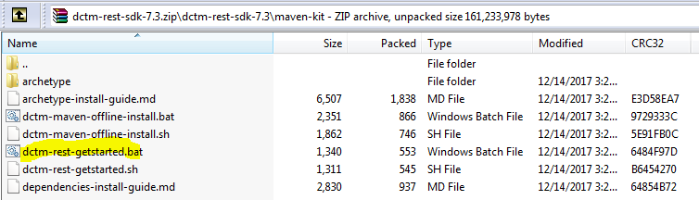
Custom REST Services
Creates REST Services which contains OOTB REST Services and the extended alias sets services
Install Maven for Documentum REST Services
Run the batch script in console dctm-rest-getstarted.bat file in the below location
It will create and build a sample Documentum REST Project in the directory <SDK-ROOT>/maven-kit/generated/acme-rest/**
SDK Provides README File /archetype-install-guide.md to illustrate how to execute the steps manually

Slide 113
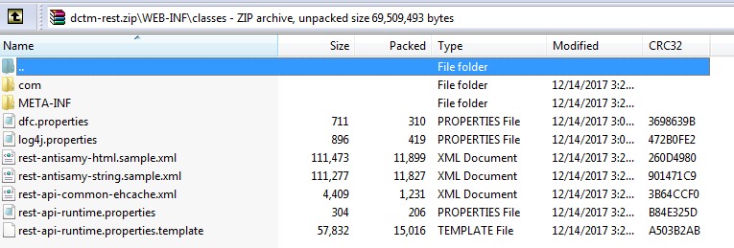
Custom REST Services (Contd)
Custom WAR File is built at the location
<SDK_ROOT>/maven-kit/generated/acmerest/acme-rest-web/target/test.war
Update dfc.properties in the below location

Slide 114
Create Custom REST Services (Contd)
It is very difficult to modify the file in archived WAR File
The other option is to modify pom.xml and rebuild the war file
The build will populate the dfc.properties to the WAR during the build
Pom.xml root is SDK_ROOT>/maven-kit/generated/acme-rest/pom.xml
War file is deployed in app server
Validate the REST Services
From the repository resource, new link relation is http://identifiers.emc.com/linkrel/alias, its link collection and its points to new developed alias set collection resource
GET /acme-rest/repositories/REPO.json HTTP/1.1
You can then navigate down to the alias sets collection via this link relation.
GET /acme-rest/repositories/REPO/alias-sets.json HTTP/1.1

Slide 115
You have successfully completed
Documentum Programming-DFC,DFS,REST
Notes:
Place the audio notes for this slide here

